Slide 1




SYSTEM ANALYSIS & DESIGN
Group 1
Puja
2003151
Riyad
2003152
Anika
2003153
Sajid
2003154

Slide 2






About Tech. Rajshahi
Leading tech company in Northern Bangladesh
Specializes in digital transformation in sectors like healthcare, education, and commerce
MISSION
Deliver unparalleled digital experiences and exceed client expectations with innovative solutions.
VISION
Use technology to revolutionize industries and enhance lives

Slide 3

PROBLEM IDENTIFICATION
PROJECT OBJECTIVES
Automated Workflow
Monitor Performance
Use AI Insights
Upskill Employees
Talent Retention Issue
E-commerce Skill Gap
Profitability Challenges
Client Satisfaction Gap

Slide 4
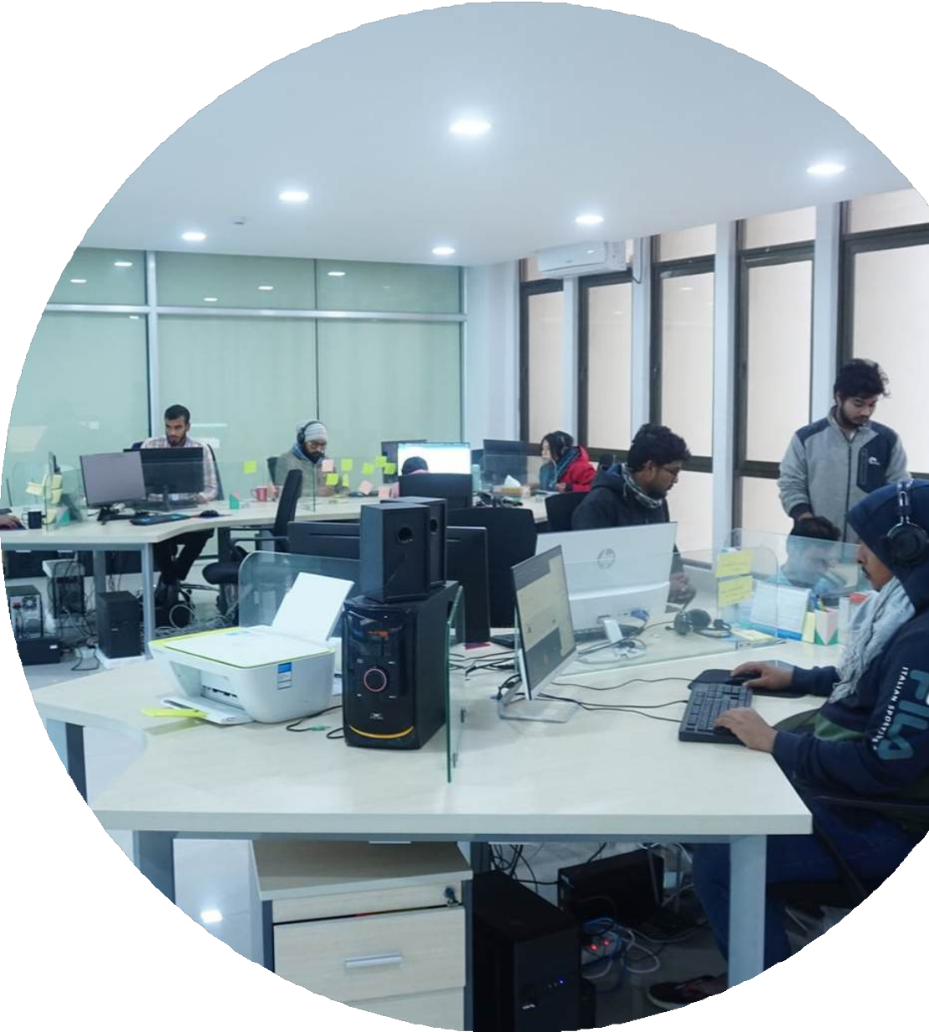
INFORMATION GATHERING TOOLS:
On-Site Observation
Key Points from the Interview
Work Environment and Culture
Employee Interactions
Use of Technology and Tools
Productivity Levels
Training and Development
Target Customers: Focus on global e-commerce sellers (Amazon, eBay, Walmart, etc.).
Expanding Brand: Growth from 3 to 45 employees with 100+ international clients.
Building Brand Awareness: Uses AI tools, client referrals, and quality service to grow globally.
Challenges: Lack of skilled workforce in Rajshahi solved through internships and training.

Slide 5
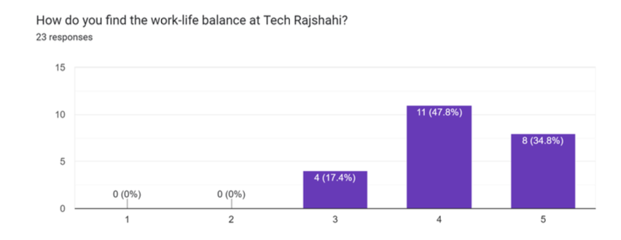
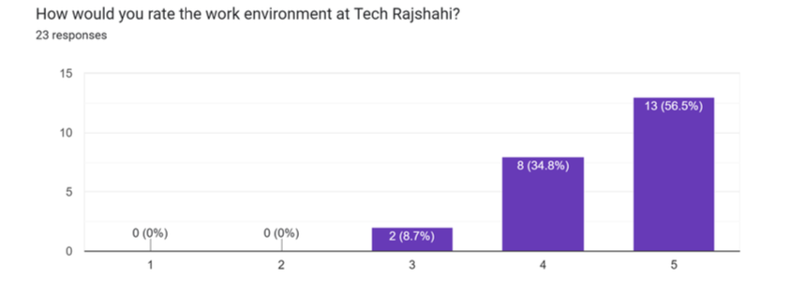
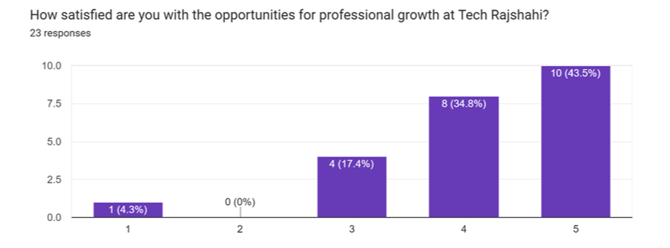
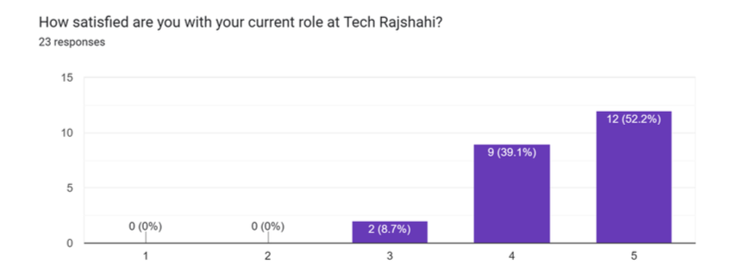
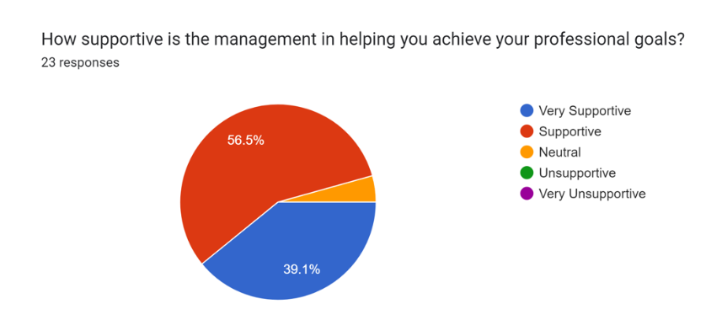
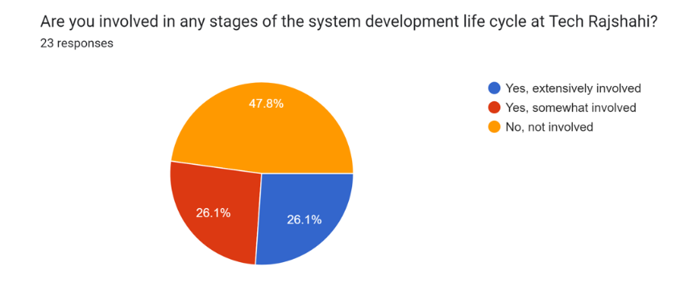
QUESTIONARRIES
We surveyed about twenty-three employees of Tech Rajshahi Ltd. Via Google Forms on various topics, including job satisfaction, work life balance, and management etc. and the statistics are-

Slide 6
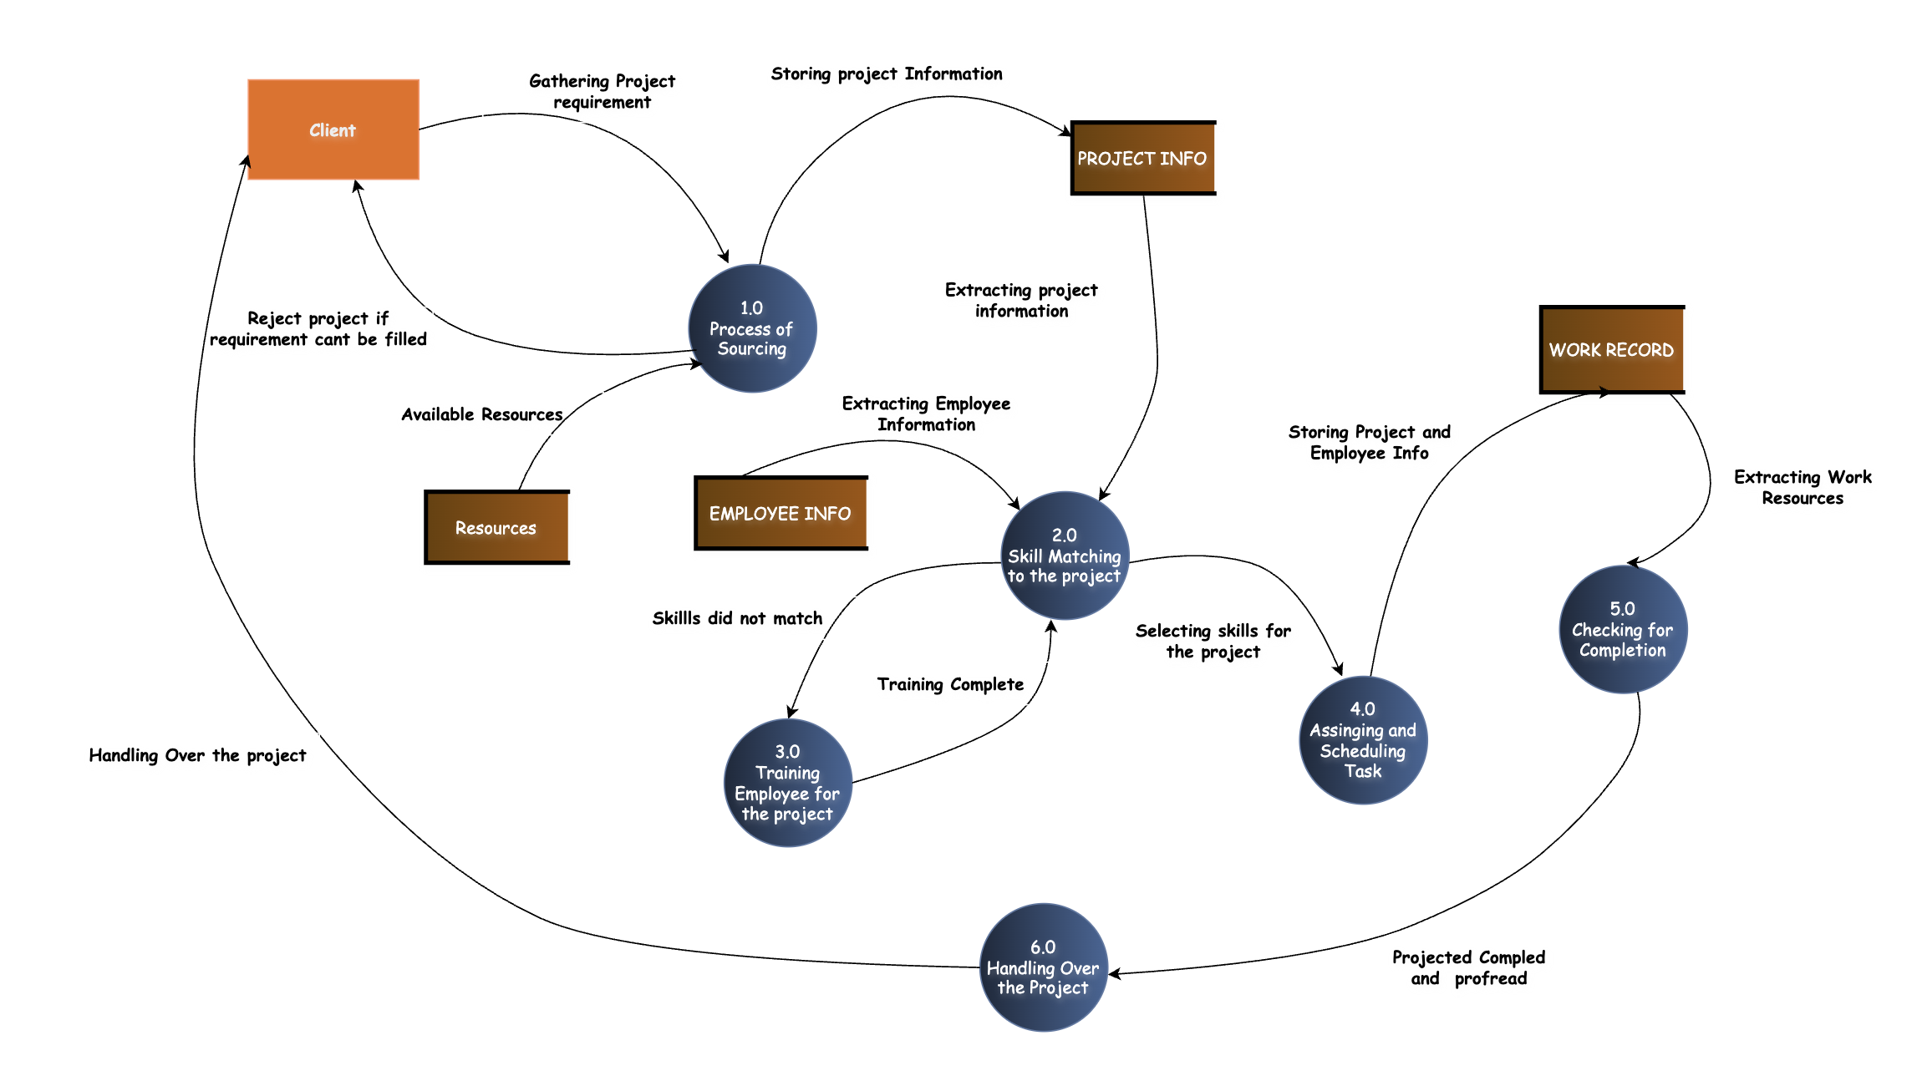
TOOLS OF STRUCTURED ANALYSIS
DATA FLOW DIAGRAM (DFD)
A visual representation of data flow between the processes of a system

Slide 7
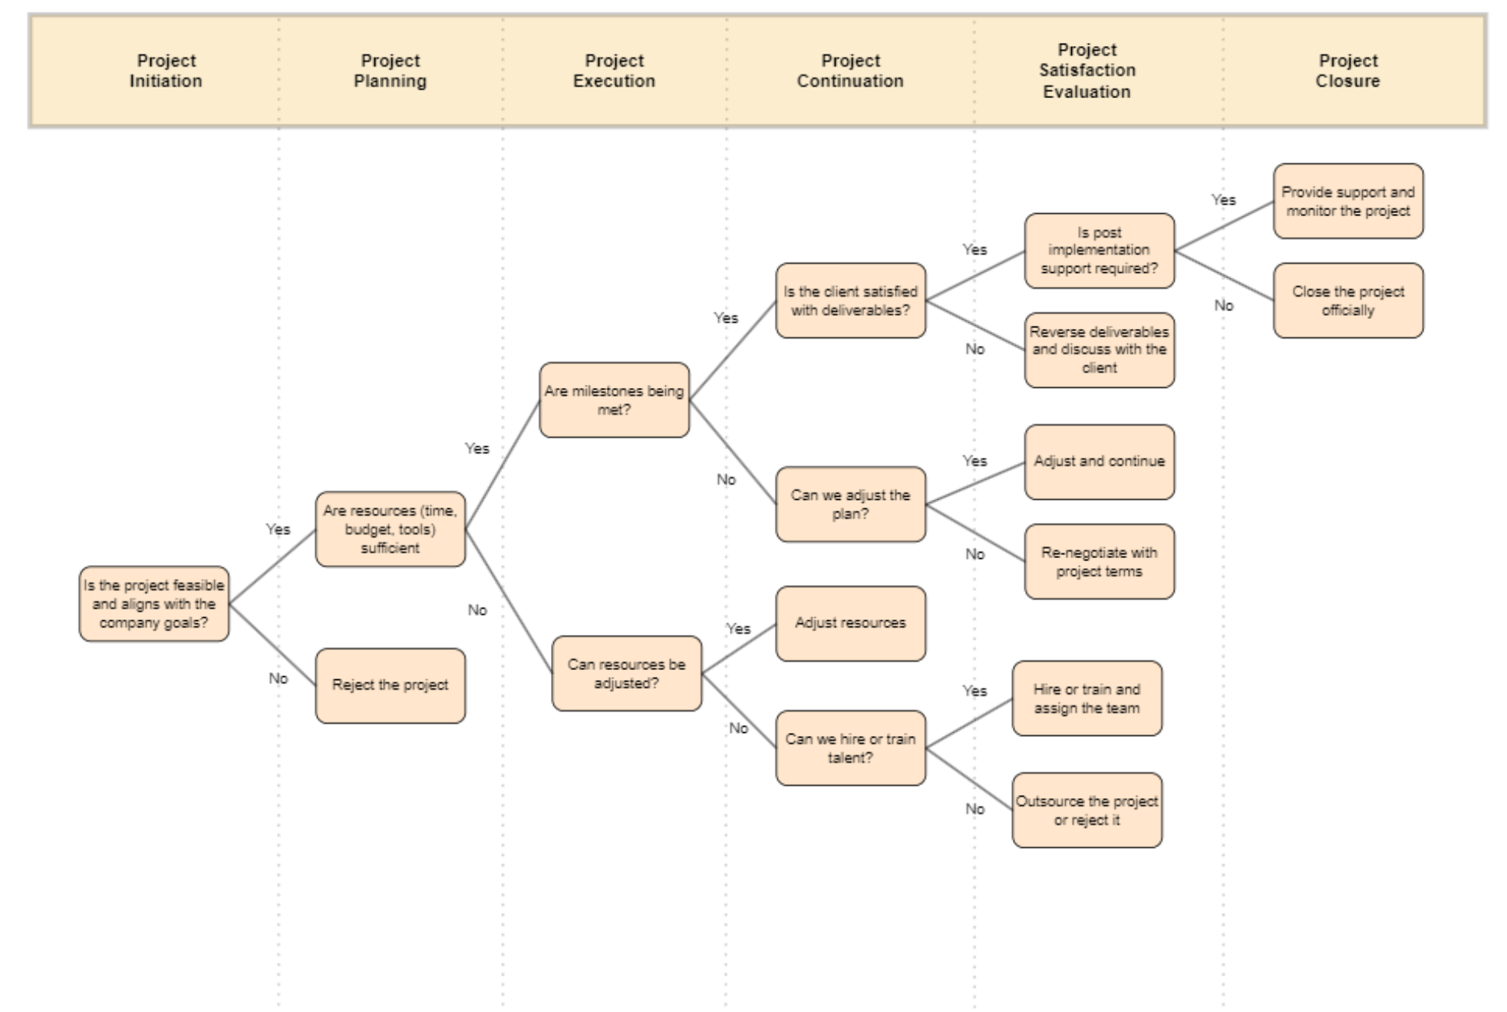
TOOLS OF STRUCTURED ANALYSIS
DECISION TREE(DT)
A logical representation of the system

Slide 8
FEASIBILITY STUDY
Economic
Cost analysis
Profit estimation
Investment planning
Technical
Resource availability
Technology assessment
System customization
Behavioral
User attitude
Employee adaptation
Training requirements

Slide 9
Candidate System 1 : Enhanced E-commerce Platform Integration
Online Client Portal
CRM Integration
Basic Automation
Candidate System 2 : A I - Powered Project Management and Automation
AI-Driven Skill Matching
Automated Task Scheduling Resource Optimization Internal Focus
Advanced Automation

Slide 10
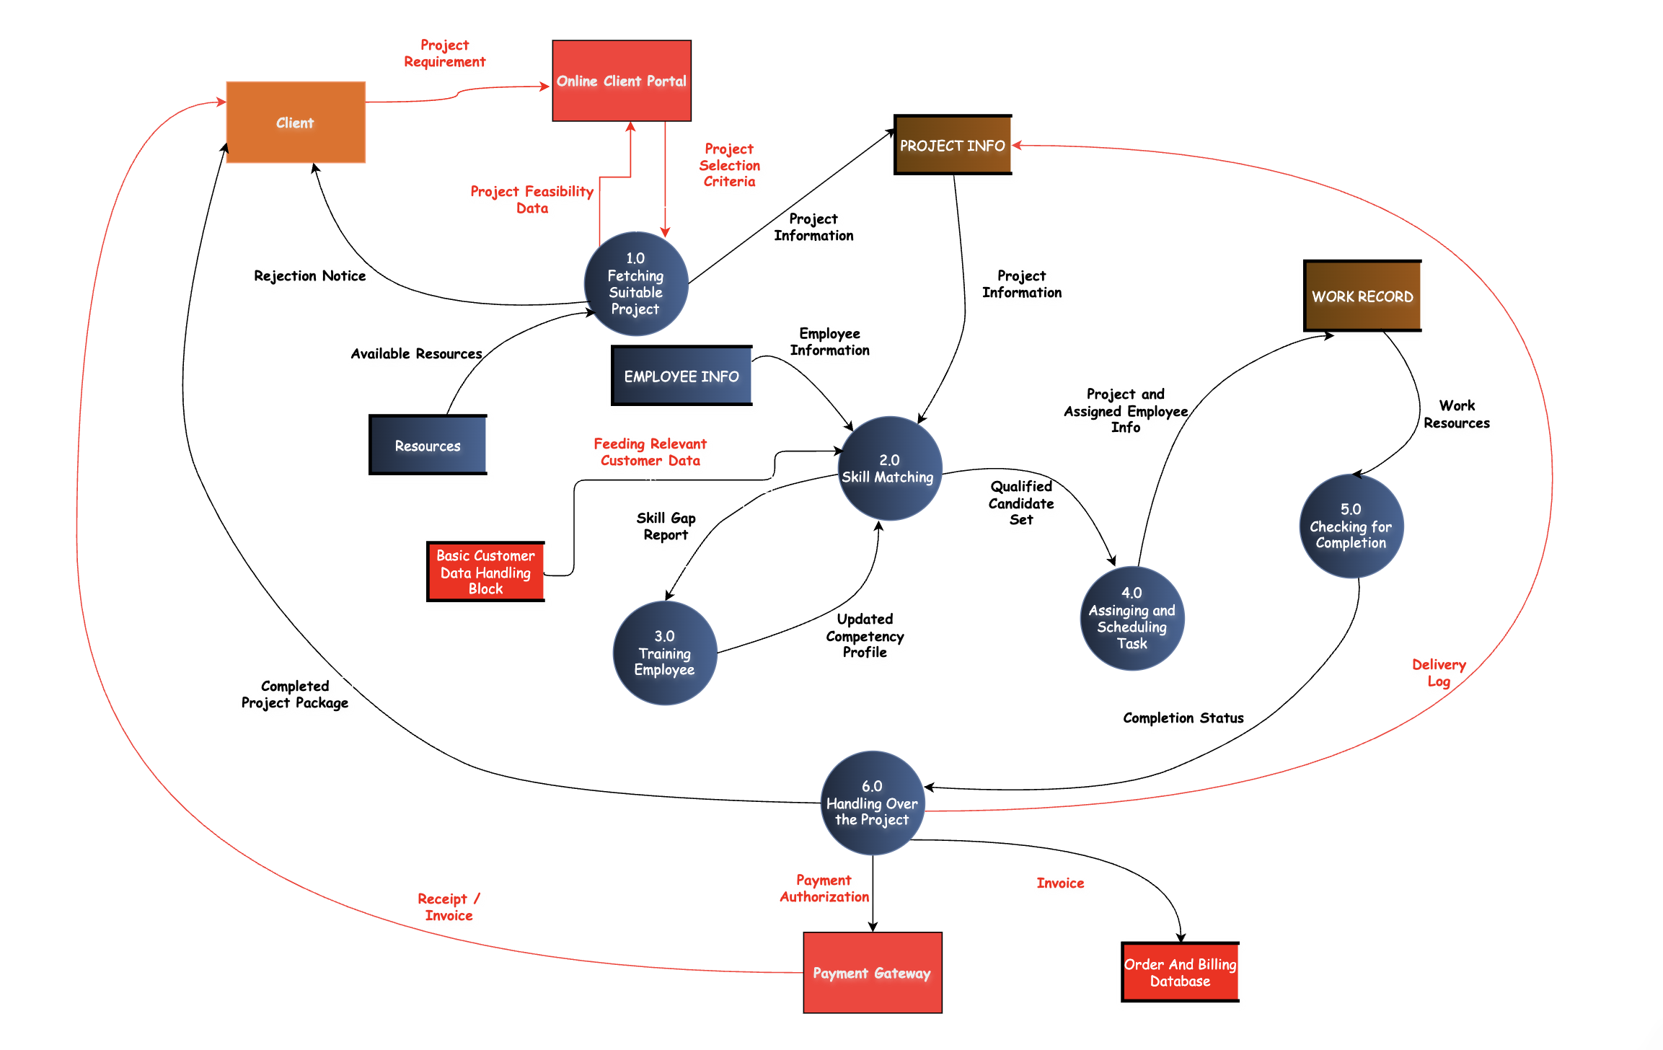
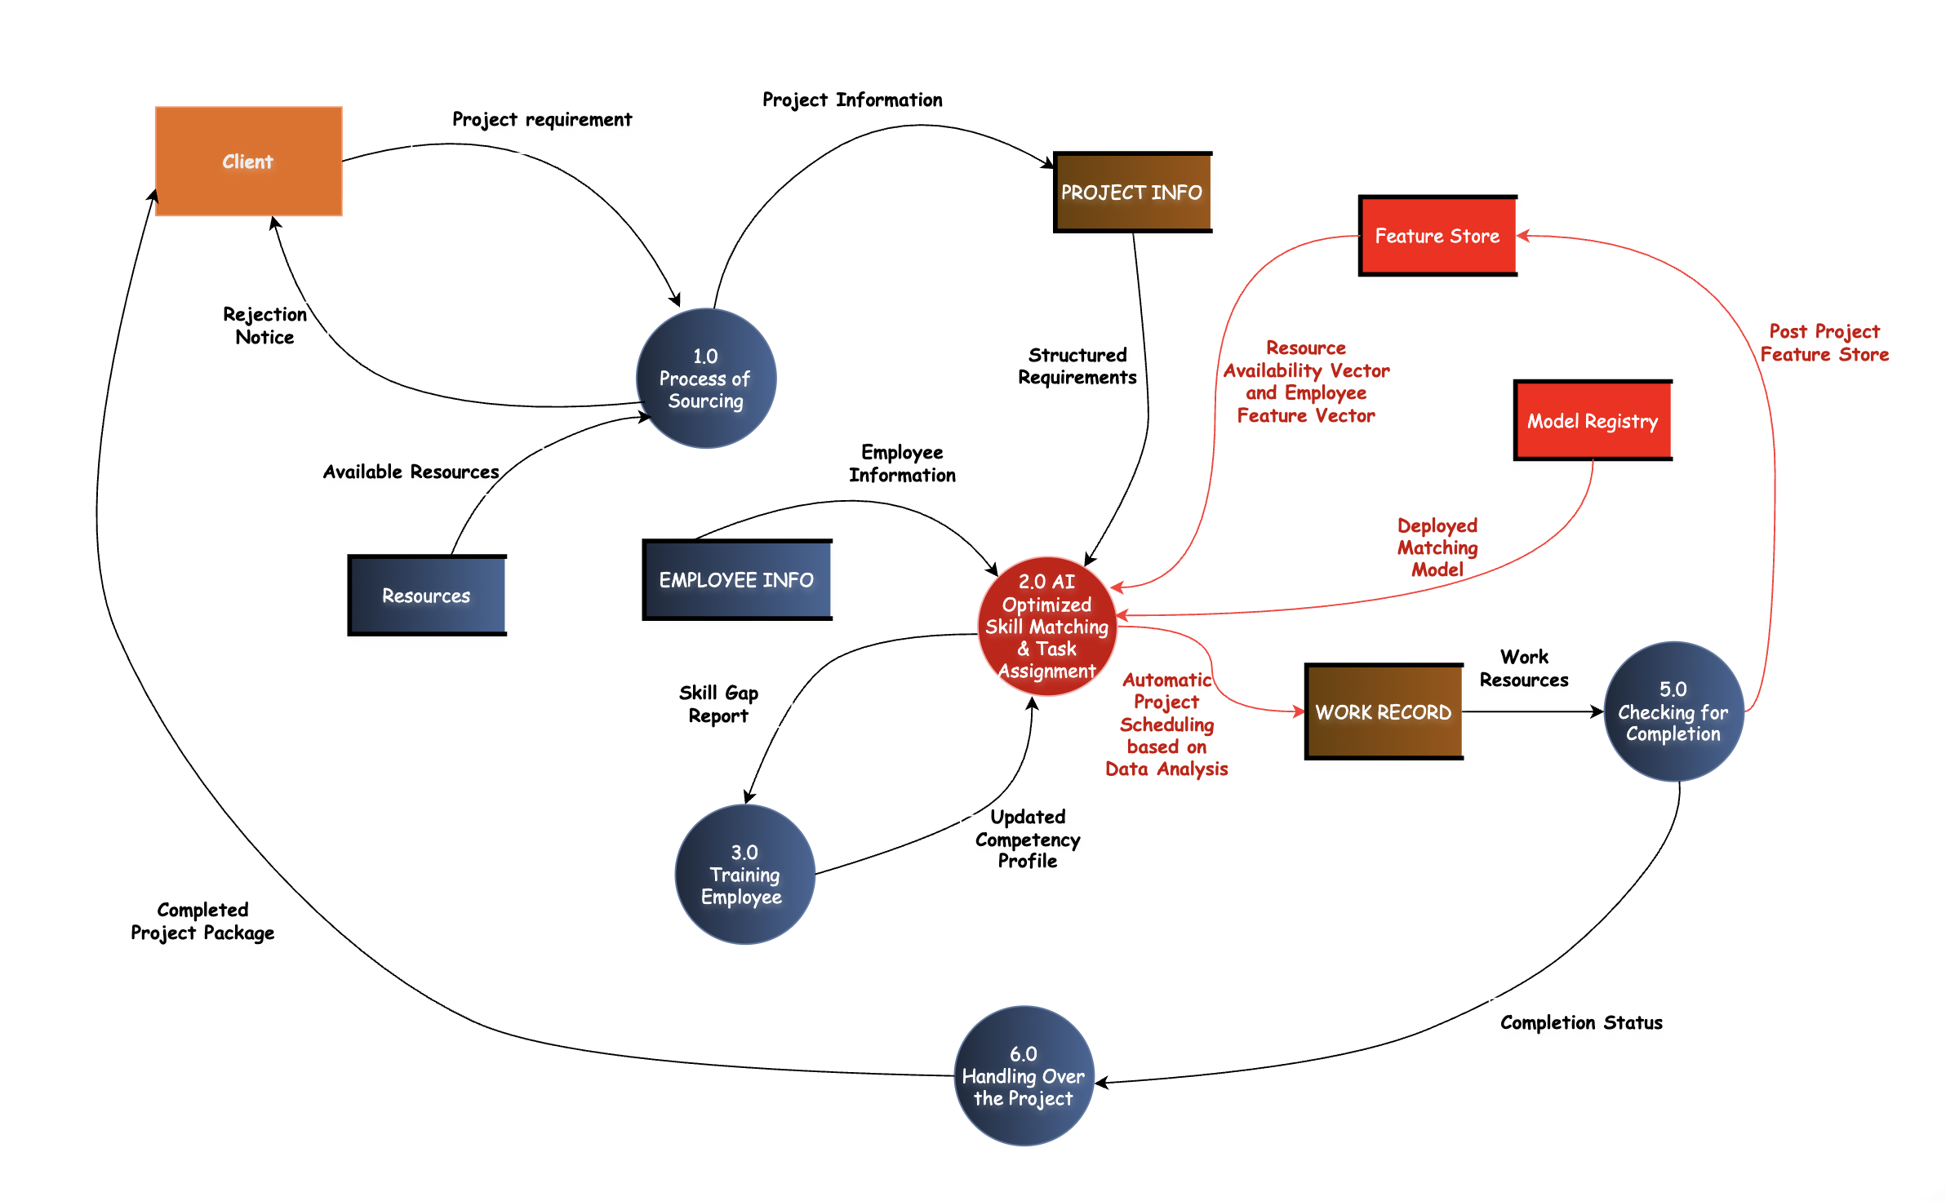
PROPOSED CANDIDATE SYSTEMS
Enhanced E- commerce Platform Integration
AI–Powered Project Management and Automation

Slide 11
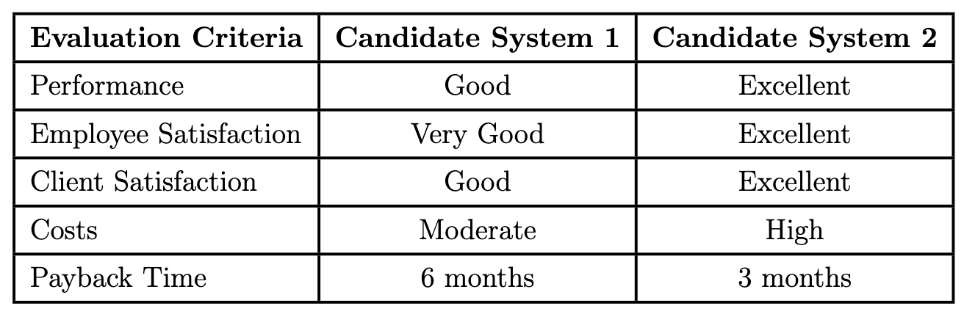
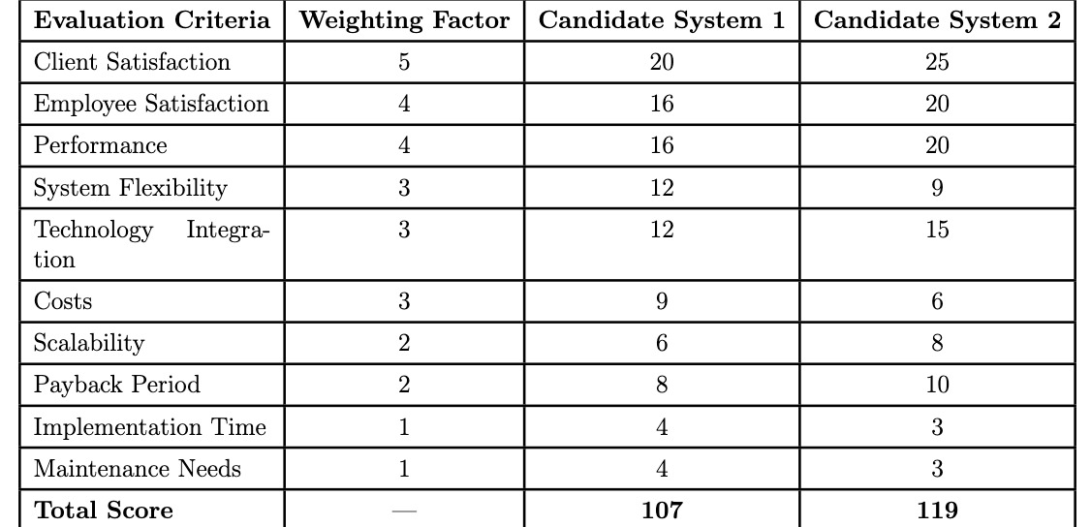
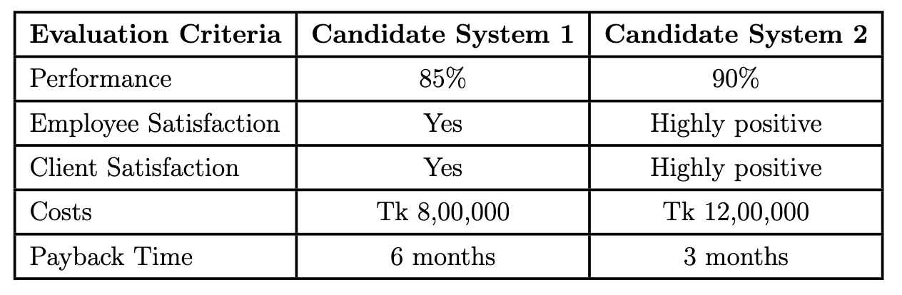
PERFORMANCE ANALYSIS
Qualitative Evaluation Matrix
Weighted Candidate Evaluation Matrix
Cost Evaluation Matrix
Selected Candidate System: Candidate System 2

Slide 12
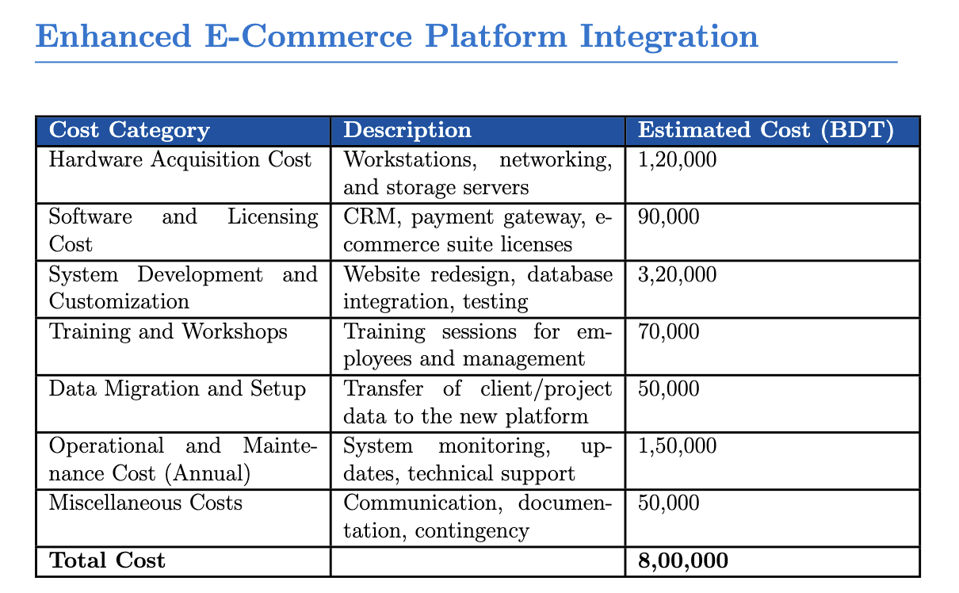
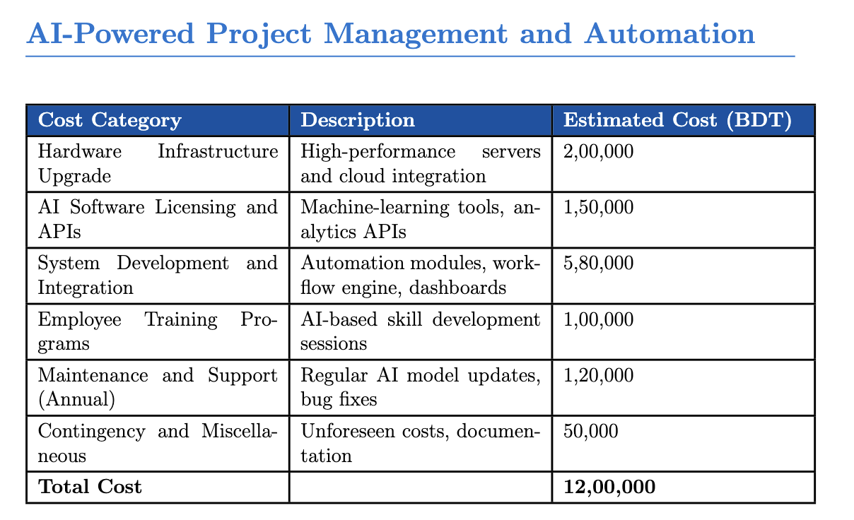
COST-BENEFIT ANALYSIS (CBA)
Objectives:
1. To evaluate the financial performance using payback period, ROI, and cost–benefit ratio
2. To select the system that provides the most favorable balance between cost and benefit

Slide 13
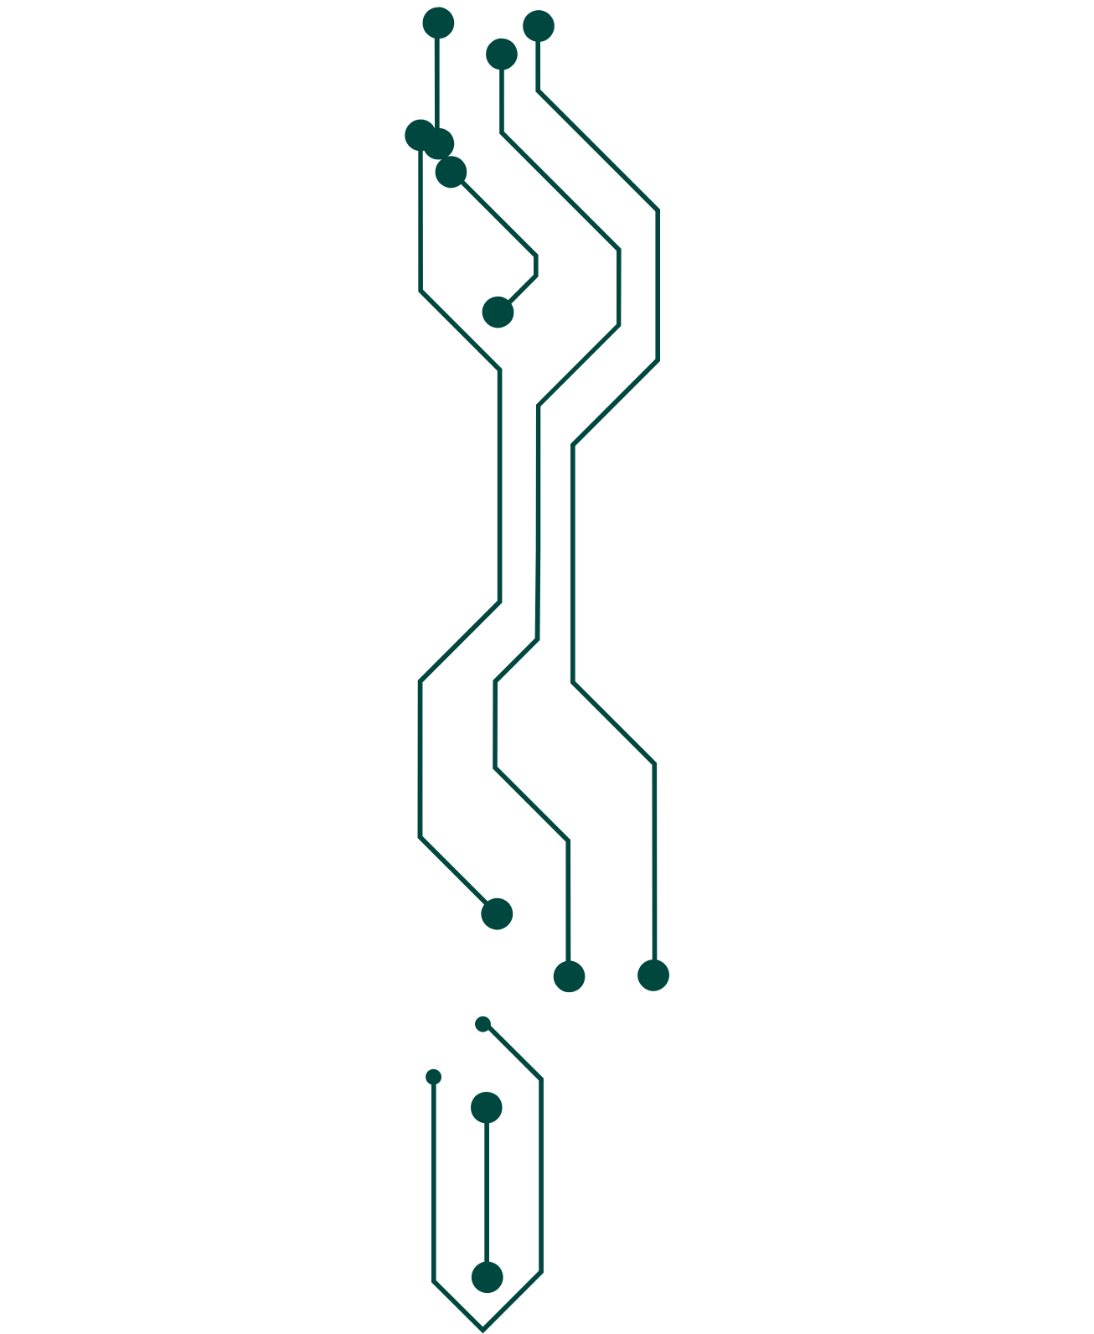

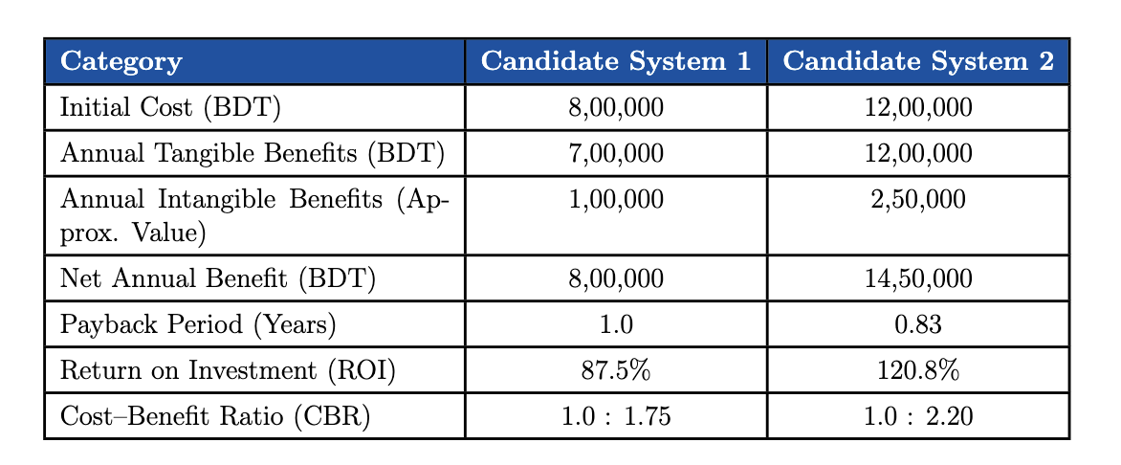
Comparative Cost–Benefit Summary
Conclusion
AI-Powered Project Management and Automation (Candidate System 2) out performs The Enhanced E-commerce Platform (Candidate System 1).

Slide 14
DFD OF THE RECOMMENDED SYSTEM

Slide 15
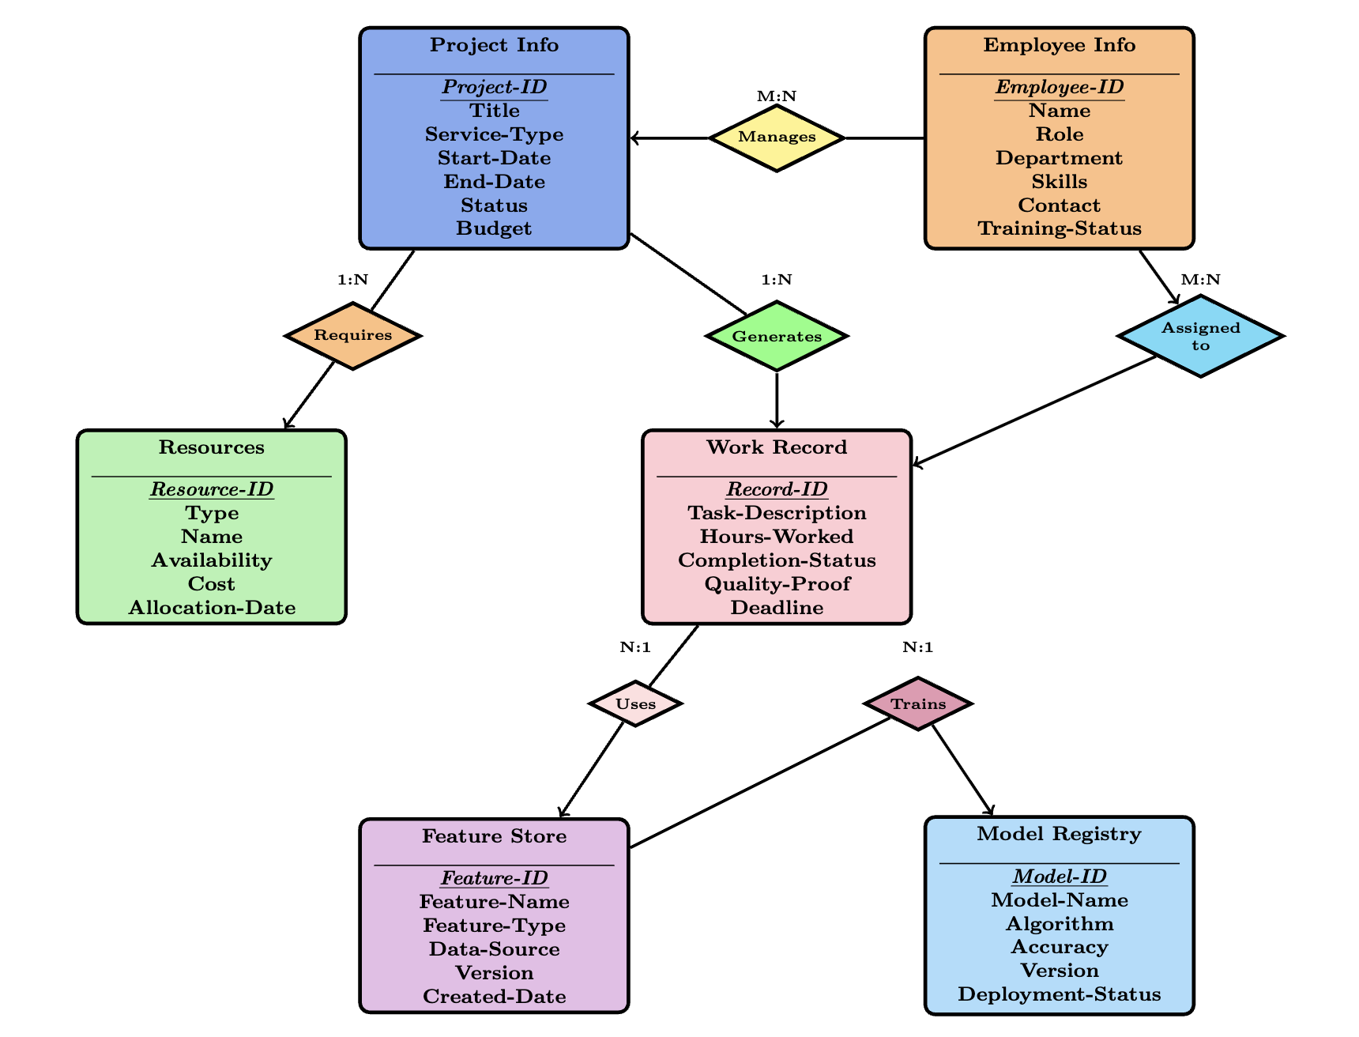
ENTITY-RELATIONSHIP DIAGRAM (ERD)

Slide 16
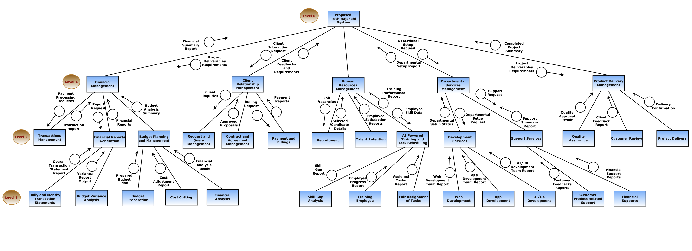
STRUCTURED CHART

Slide 17
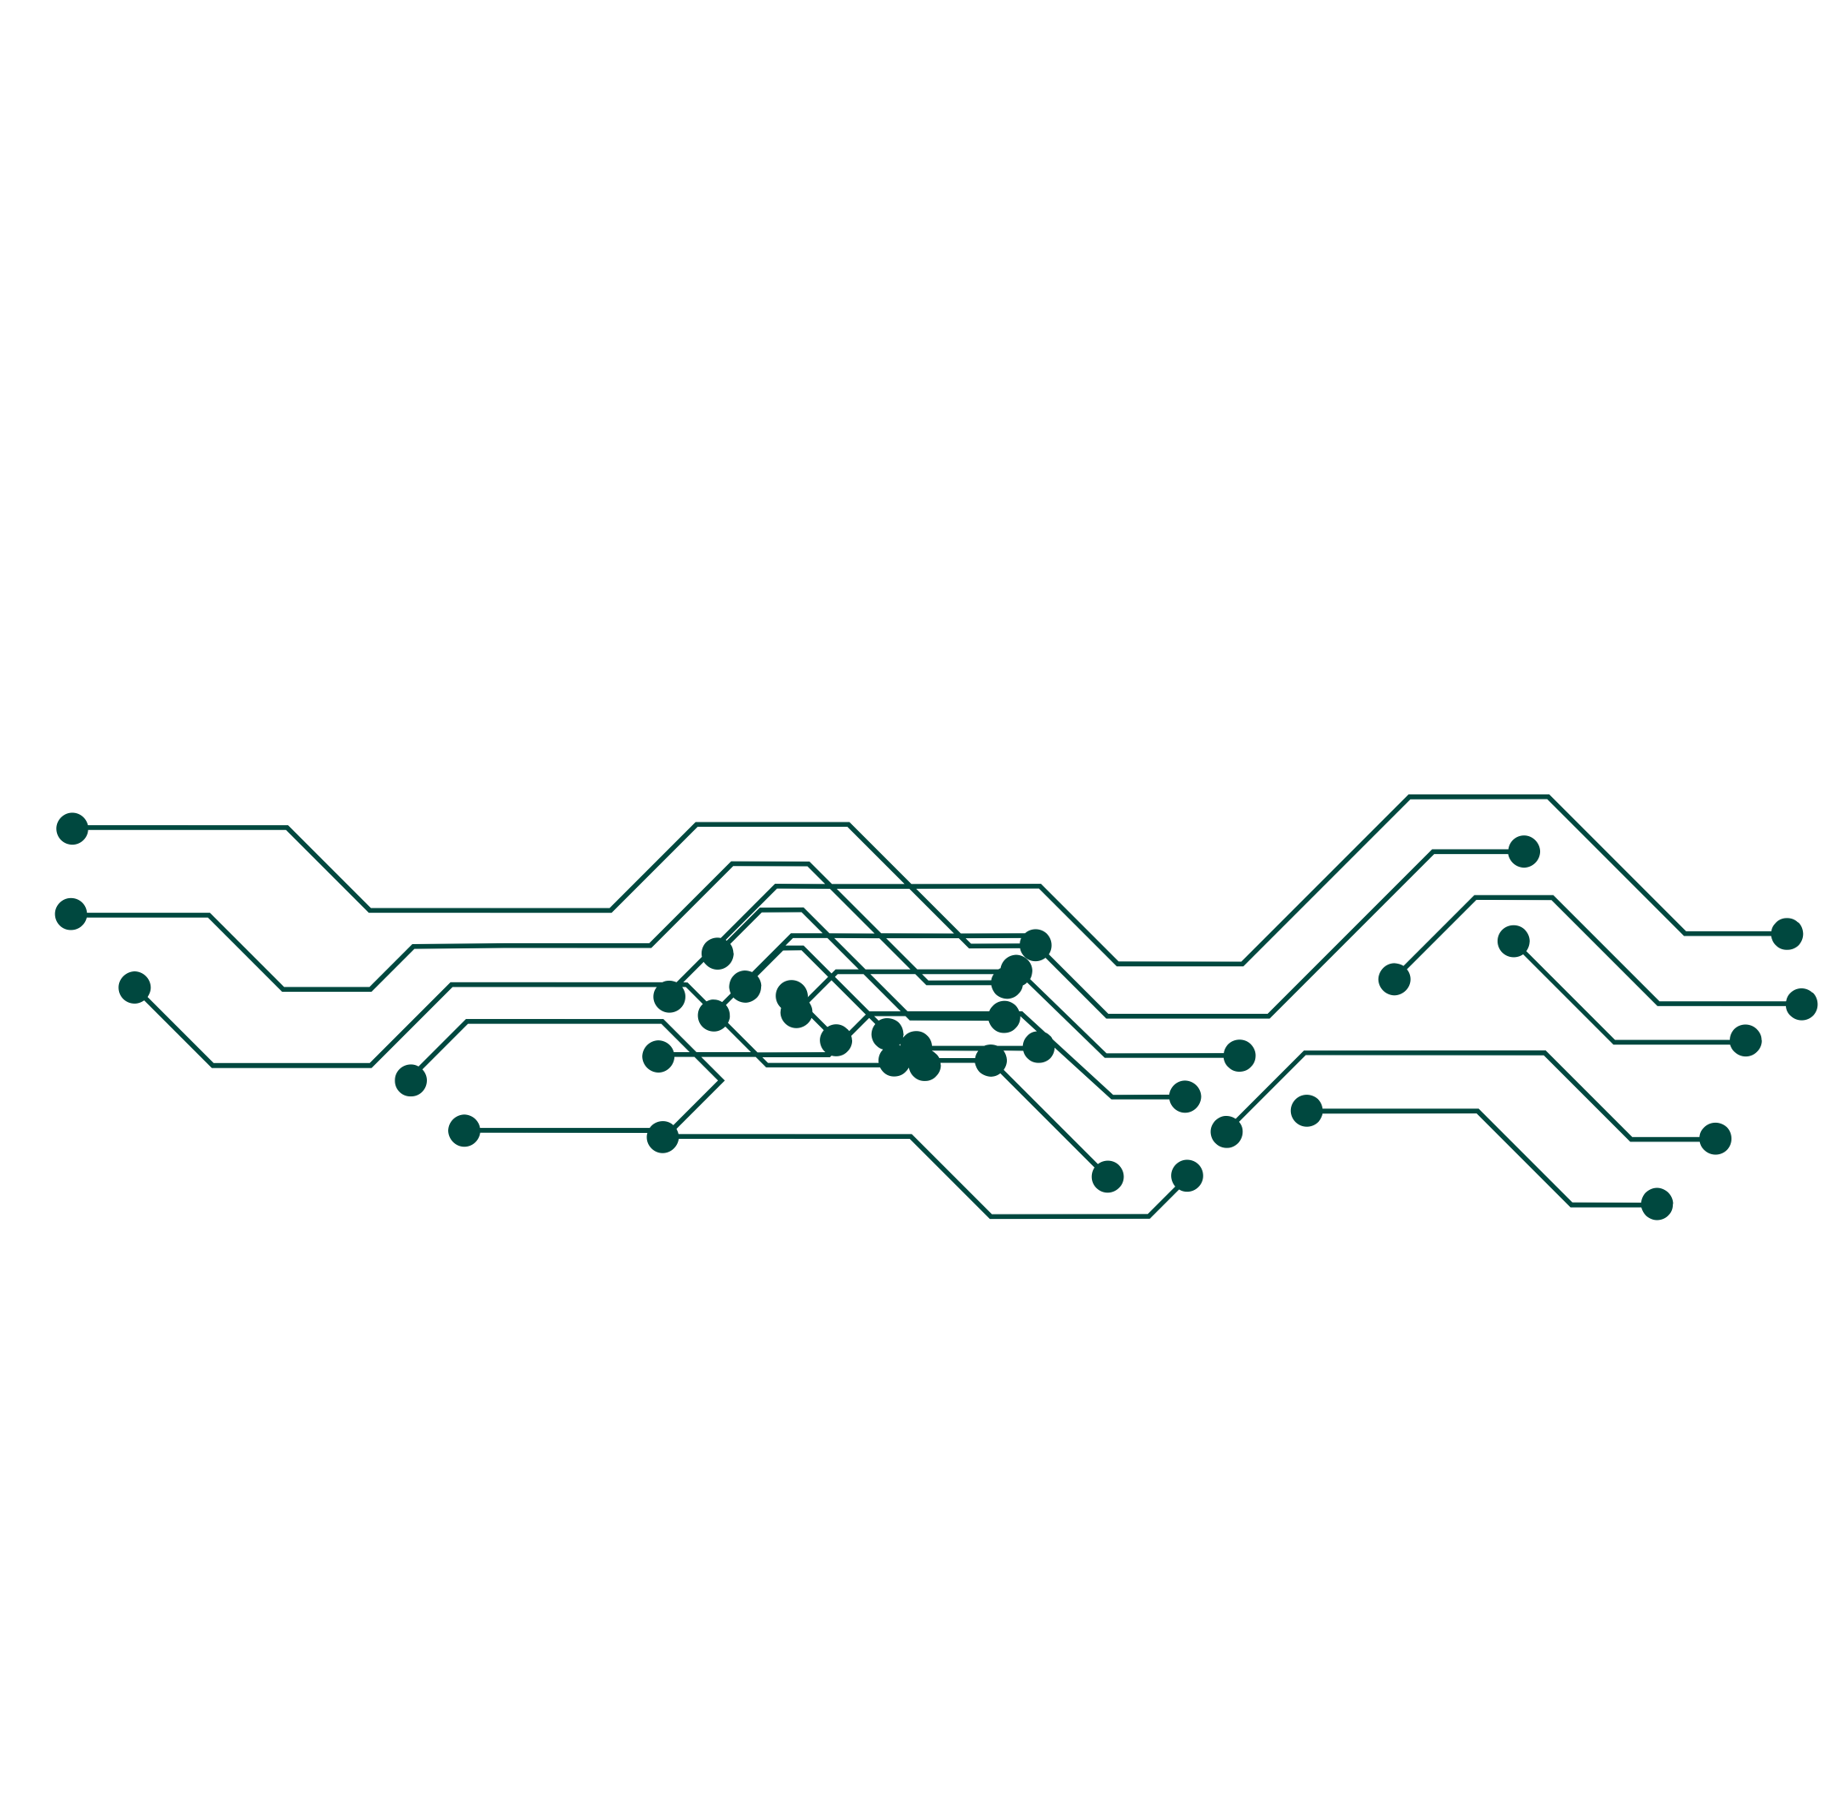
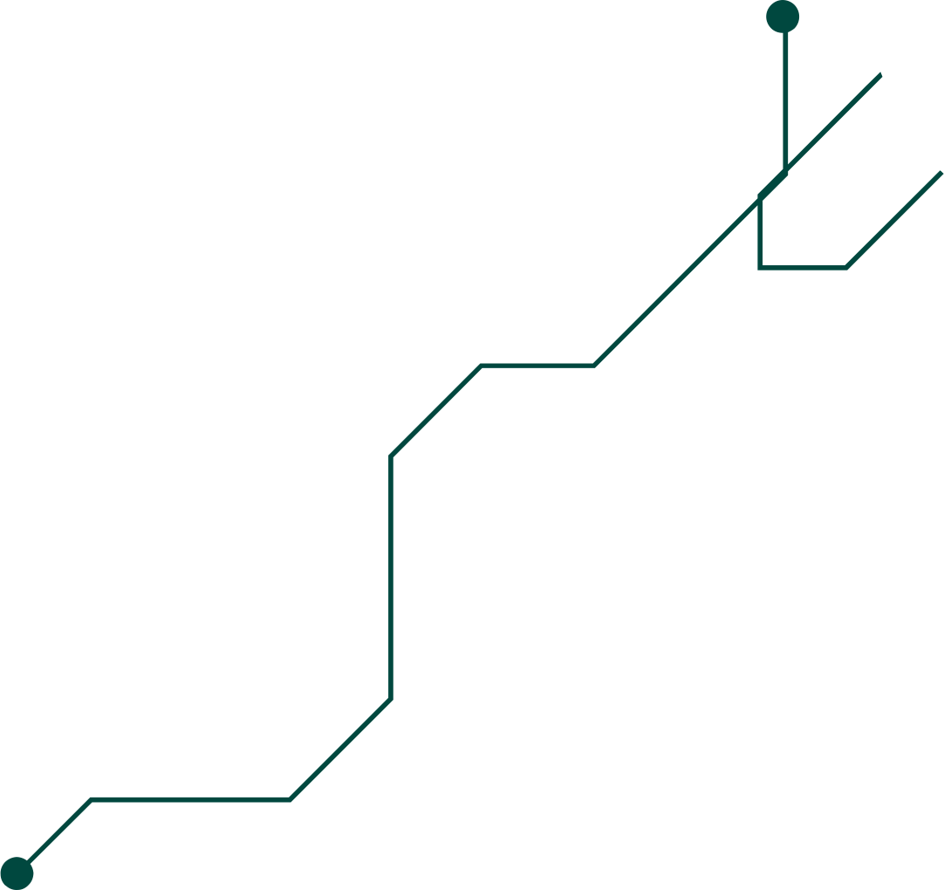




THANK YOU!!

